Slide 1
CSCE 313 – Exceptions Control flow
Reading Reference: Textbook Chapter 2
Aakash Tyagi CSCE 313 Spring 2016
January 26, 2016

Slide 2
Before we start…
Machine Problem Teams to be finalized by Friday Jan 29th. Please talk to Tanzir if you need any help (reorg on section, or wish to work alone, or help id teammate, etc.).
Today Jan 28: I will publish homework practice questions for discussion so far.
Tuesday Feb 2: Quiz based on material covered through Thu Jan 28.

Slide 3
Quick Recap from Jan 26 Discussion
What is an example of an OS as (a) Referee, (b) Illusionist, (c) Glue?
Referee: Management of Resources (I/O, Memory, CPU, etc.)
Illusionist: Multiprogramming, Virtual Memory
Glue: Library functions to give the same look and feel to multiple apps. For example, disks can be from different manufacturers yet to the programmer, it is the same programming interface.
How would you describe the old Batch Operating Systems? Time Sharing OS?
Batch OS: Submit jobs in batches; DMA handles IO
Time Sharing OS: CPU allocation cycles through the jobs in a defined order

Slide 4
Quick Recap from Jan 26 Discussion
What are the key challenges faced by OS Designers?
Reliability, Availability, Serviceability, Security, Performance, Portability
And finally we looked at an example where a High Level Language had certain lines that executed in a privileged mode (e.g. drawing the bat on screen pixel-by-pixel)

Slide 5
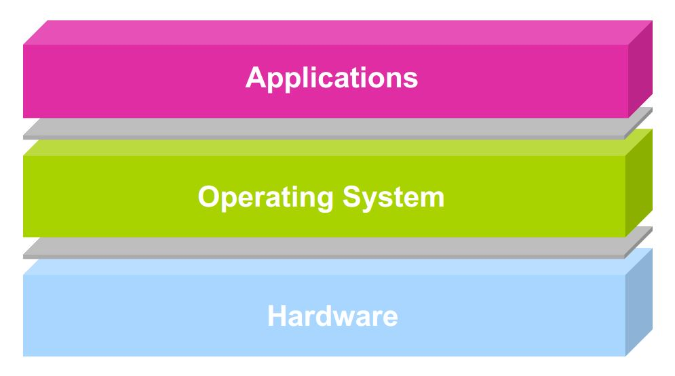
A Typical Computer System
The “all powerful” “all access” portion of OS Code is called the KERNEL

Slide 6
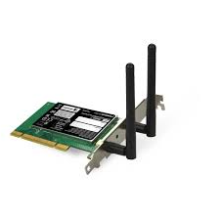
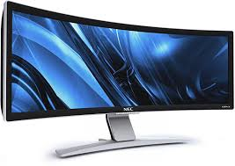
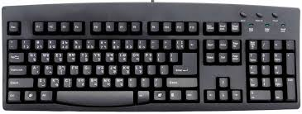

Scope of CSCE-313
user1
user2
user3
user4
Application Programs/Processes
return
System calls,
Exceptions
Privileged
Operations
Processor
Memory
INT
Character O/P
Bock I/O
storage
In this course we will be exploring the interfacing components on all three interfaces:
Application ←→ OS Kernel, OS Kernel ←→ CPU/Memory, CPU ←→ External Hardware

Slide 7
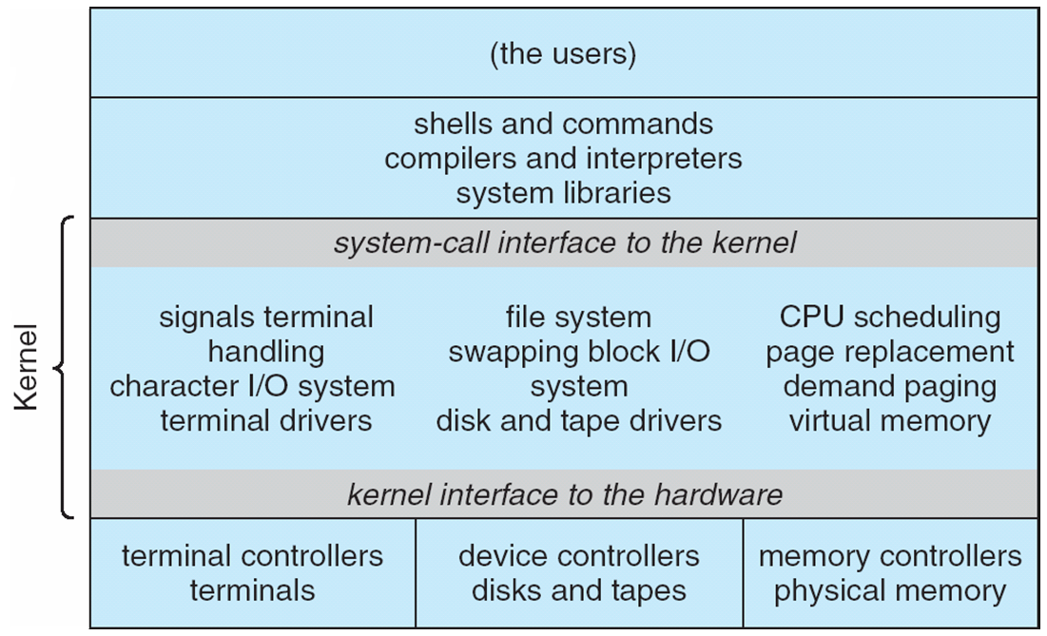
Traditional UNIX System Structure

Slide 8
A Real-Life Analogy (Approximate)
A Typical Coffee Shop | Computer System
Store | System
Customer | Process or Program or User Application
Barista/Cashier | Operating System Kernel, Privileged Code
Coffee Machine | CPU
Customer Order | System Call
Order item not on Menu | Exception
Telephone Call | Interrupt
Fire Alarm | Signal
>1 Customers being served | Process Scheduling
Customer realizing at the counter that he needs to go to ATM to get money | Process Context Switching

Slide 9
Today’s Discussion
user1
user2
user3
user4
Application Programs/Processes
return
System calls,
Exceptions
Privileged
Operations
Processor
Memory
INT
Character O/P
Block I/O
INT
storage
Today we will be discussing “Exception Control Flows” and
preview System Calls in a Computer System
Acknowledgment for Control Flow Slides: Prof. Keunning, HMC, FA’14

Slide 10
Control Flow
Computers do only one thing
From startup to shutdown, a CPU simply reads and executes (interprets) a sequence of instructions, one at a time
This sequence is the system’s physical control flow (or flow of control)
Physical control flow
<startup>
inst₁
inst₂
inst₃
…
inst_{n}
<shutdown>
Time

Slide 11
Altering the Control Flow
Program-assisted mechanisms for changing control flow:
Jumps and branches—react to changes in program state
Call and return using stack discipline—react to program state
Insufficient for a useful system
Difficult for the CPU to react to other changes in system state
Data arrives from a disk or a network adapter
Instruction divides by zero
User hits control-C at the keyboard
System needs mechanisms for “exception control flow”

Slide 12
Exception Control Flow
An exception is a transfer of control to the OS in response to some event (i.e., change in processor state)
User Process
OS
event
current
exception
next
exception processing
by exception handler
exception
return (optional)

Slide 13
Asynchronous Exceptions (Interrupts)
Caused by events external to processor
Indicated by setting the processor’s interrupt pin(s)
Handler returns to “next” instruction.
Examples:
I/O interrupts
Key pressed on the keyboard
Arrival of packet from network
Hard-reset interrupt
Hitting reset button
Soft-reset interrupt
Hitting control-alt-delete to initiate restart on a PC

Slide 14
Interrupt Vectors
Exception
numbers
Each type of event has a unique exception number k
Index into jump table (a.k.a., interrupt vector)
Jump table entry k points to a function (exception handler).
Handler k is called each time exception k occurs.
code for
exception handler 0
interrupt
vector
code for
exception handler 1
0
1
code for
exception handler 2
2
...
n-1
...
code for
exception handler n-1

Slide 15
Synchronous Exceptions (Traps, Faults, Aborts)
Caused by events that occur as result of executing an instruction:
Traps
Intentional
Examples: system calls, breakpoint traps, special instructions
Returns control to “next” instruction
Faults
Unintentional but possibly recoverable
Examples: Page Faults
Either re-executes faulting (“current”) instruction or aborts

Slide 16
Synchronous Exceptions (Traps, Faults, Aborts)
Caused by events that occur as result of executing an instruction:
Aborts
Unintentional and unrecoverable
Examples: parity error, machine check
Aborts current program or entire OS

Slide 17
Trap Example
Opening a File
User calls open(filename, options)
Function open executes system-call instruction: int $0x80
OS must find or create file, get it ready for reading or writing
Returns integer file descriptor
User Process
OS
int
exception
pop
Open file
return

Slide 18
Fault Example #1
int a[1000];
main ()
{
a[500] = 13;
}
Memory Reference
User writes to memory location
That portion (page) of user’s memory is currently on disk
Page handler must load page into physical memory
Returns to faulting instruction
Successful on second try
User Process
OS
event
page fault
Create page and load into memory
return

Slide 19
Fault Example #2
Illegal Memory Reference
User writes to memory location
Address is not valid
Page handler detects invalid address
Sends SIGSEGV signal to user process
User process exits with “segmentation fault”
int a[1000];
main ()
{
a[5000] = 13;
}
User Process
OS
event
page fault
Detect invalid address
Signal process

Slide 20
Summarizing Control Flow Exceptions
Events that require nonstandard control flow
Are Synchronous (Traps, Faults, Aborts) OR Asynchronous (I/O Interrupts, Hard or Soft Reset etc.)
Generated Externally (interrupts) or Internally (traps and faults)
OS decides how to handle

Slide 21
Preview: User/Kernel (Privileged) Mode
User Mode
interrupt
FP exception
syscall
rtn
FP Exception error
rfi
Kernel Mode
exit
exec
Limited HW access
Full HW access
Notes:
Processor routinely checks for interrupts and if one is logged, it goes back to save the state of the process it is executing and enters the kernel to service the interrupt. The service is done by entering a interrupt vector table which contains the address of the specific interrupt service routine. Once the routine is serviced the kernel gives control back to the user process.
In multiprocessor systems, only one processor has to service the interrupt from an external device.
What happens when you move a mouse pointer? Each move or point or click registers as an interrupt which is noticed by the processor which moves the control back to the Kernel to service the interrupt routine and that shows up as an action to its associated process (e.g. move of mouse pointer in the active window, or highlight of a word selected, etc.)
An alternative to Interrupt would be “polling” where the Kernel would go in a round-robin fashion to check the status of each device to see if they have an interrupt.

Slide 22
Example: Web Server
syscall
syscall
syscall
RTU
RTU
wait
wait
interrupt
interrupt

Slide 23
In Closing
Today we learnt the importance and various forms of how applications eventually get the attention of underlying System Hardware and Software (privileged code to keep sanity, illusions, and glues)
We saw an interesting analogy with a coffee shop and also looked at some real CS System examples illustrating exception control flow.
On Tuesday, we will dive a little deeper into Dual Mode Operation. Read Chapter 2 in entirety to prepare for an interesting discussion.
Please start working on MP1. It has elements of surprise and we don’t want you to be surprised with its complexity. MP2 builds on top of MP1.

